Slide 1
AQUABOTS Aeropak
Integrated Status Review
Team 26061

Slide 2
Overview
1.0 Introduction
2.0 Post-CDR Changes
3.0 Parts Status
4.0 Assembly and Integration
5.0 Testing and Verification
6.0 Risk Analysis
7.0 Budget and Deliverables
8.0 Summary
Notes:
Jamie

Slide 3
Introduction

Slide 4
Our Team
Jamie Ledbetter, Biosystems Engineering – Team Lead
Robert Wilkie, Aerospace Engineering – Procurement Lead
Alex Imrich, Aerospace Engineering
John Lopez, Electrical Engineering
Mayra Mendoza, Optical Engineering
Kama Henriques, Mechanical Engineering

Slide 5
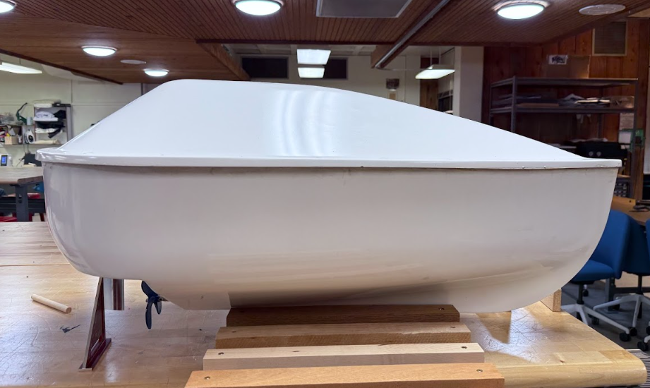
Project Summary
Purpose: Rapid, real-time environmental monitoring in marine and coastal environments
Deployment: Ocean-deployed drones self-orient within 1 minute and follow remotely set paths
Ground Station:
Live video stream from main drone
Real-time environmental data from all drones
GEO-overlay for spatial monitoring and mission control
Hull & Structure:
Self-righting, waterproof, impact-resistant design
Fiberglass enclosure protecting internal systems
Communication:
Starlink satellite antenna for continuous remote connectivity
Onboard Systems:
Jetson Nano – Controls motors, servos, and live video
ESP32 – Collects GPS, time, altitude, temperature, pH, and conductivity data
Image of AQUABOT Hull
Notes:
Jamie

Slide 6
Post-CDR Changes

Slide 7
Post-CDR Changes
Action Items: Detailed integration plans for both software and hardware
Modified sensor selection– prior pH sensors faulty due to improper maintenance
Modified sensor and camera mounts to provide more stability and minimize drag
Added flight controller to reduce control software risks
All Action Items Closed
Notes:
Jamie

Slide 8
Parts Status

Slide 9
Communications
Part Name | Weight | Supplier | Status
ESP32 | 1g | John | Purchased
Jetson Orin Nano | 0.5 kg | Amazon | Purchased
Starlink Antenna | 2 kg | Prior Team | On Hand
JST-SH 4-pin | - | Amazon | Purchased
Servo 3-pin | - | Amazon | Purchased
15-pin FPC | - | Amazon | Purchased
RJ-45/Cat 5E Cable | 0.5 kg | Amazon | Purchased
Notes:
- All comms system parts ordered
- Want to integrate the power system before putting the comms system together, so waiting to do that

Slide 10

Electronics
All parts ordered • Awaiting delivery
Part | Qty | Price | Source | Status
6S LiPo Battery (main) | 1 | $66 | Amazon | ORDERED
MRBF Fuse Holder (main) | 1 | $25 | Amazon | ORDERED
MIDI Fuse Block (thruster) | 1 | $38 | Amazon | ORDERED
ST Blade Fuse Block (aux) | 1 | $47 | Amazon | ORDERED
150A Fuse (main) | 1 | $18 | Amazon | ORDERED
125A Fuse (motor) | 1 | $12 | Amazon | ORDERED
Bus Bars (+ / –) | 2 | $100 | Amazon | ORDERED
Manual Kill Switch | 1 | $25 | Amazon | ORDERED
Castle BEC (servo 7.4V) | 1 | $47 | Castle | ORDERED
Thermal Pads + ATO Fuses + DC Pigtails | — | $39 | Amazon | ORDERED
Total: $417
All parts ordered. Awaiting delivery. Assembly begins upon arrival — no design work remaining, straight to build.
Notes:
- All power system parts ordered — $587 total across Amazon and Castle
- Awaiting delivery — assembly begins immediately on arrival
- No design changes needed, this is a straight build-and-integrate task

Slide 11
Propulsion System/Mechanical
Part Name | Weight | Supplier | Status
Motor | 680g | Apsiqueen | Installed
Rudder Servo | 90g | DSServo | Shipping
Shaft | 150g |  | Installed
Propeller | 95g | 3D Printed (3DP) | Installed
Battery | 825g | OVONIC | Ordering
Motor Mount | 82g | 3DP | Installed
Motor Flange | ~100g | 3DP/ Machine Shopped | Under Redesign
PIXHAWK 4X | 30g | PIXHAWK | Will install once servo arrives
ESC | 120g | Apsiqueen | Installed
Rudder | 30g | Machine Shopped | Installed
Notes:
Alex & Robert

Slide 12
Sensors and Camera
Part Name | Weight | Supplier | Status
IMX219 | 10 g | Amazon | Purchased, Installed
PINPOINT Marine pH Probe | 29 g | Saltwater Aquarium | Awaiting Arrival
EZO pH Circuit | 1.76 g | Atlas Scientific | Purchased
DS18B20 Waterproof Temp. Sensor | 25 g | Amazon | Awaiting Install
TDS Conductivity Sensor | 27.2 g | Amazon | Awaiting Install
Sensor Mount | TBD | CAD Part | Pending Final Print
Camera Mount | TBD | CAD Part | Printed, Installed
Notes:
Jamie

Slide 13
Assembly and Integration Status

Slide 14
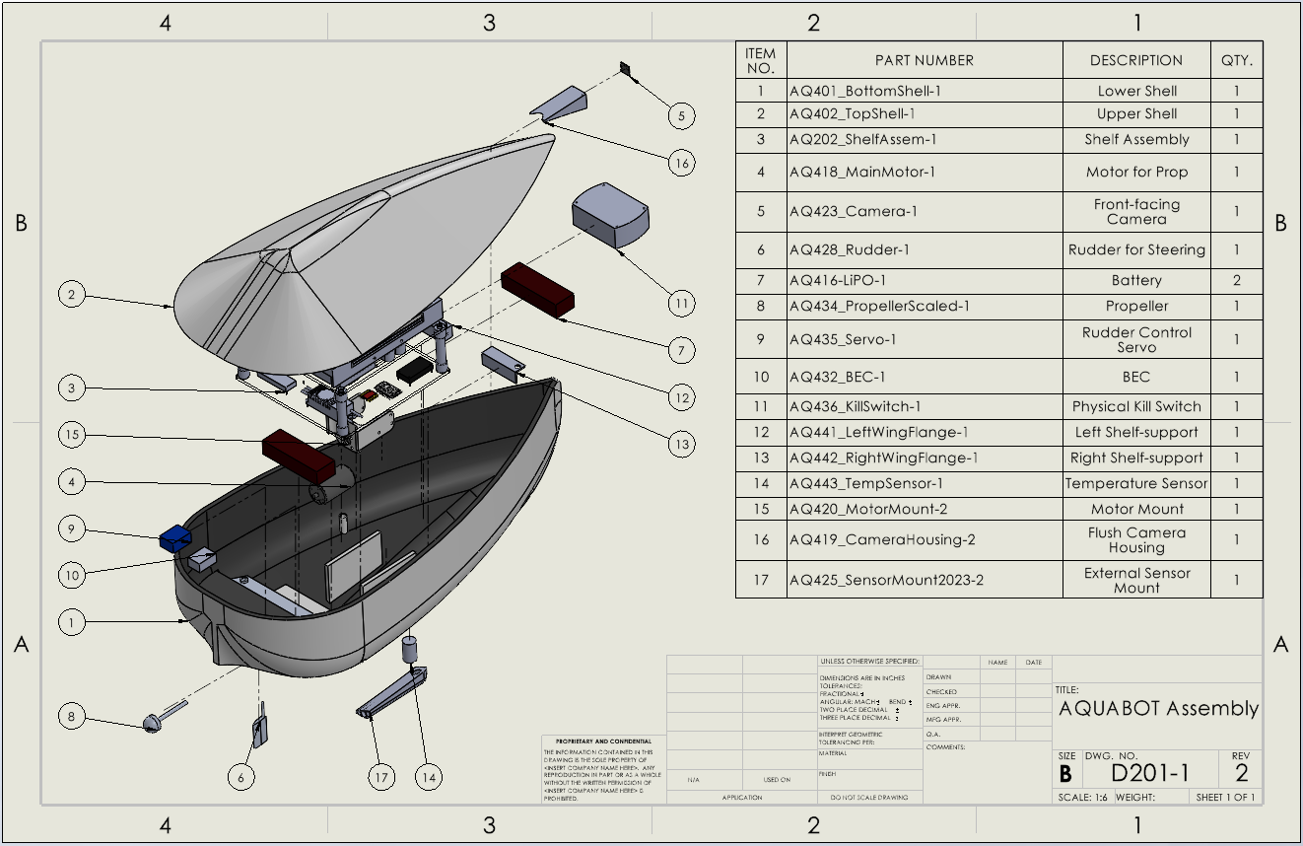
AQUABOT Assembly Drawing
Notes:
Kama:
Assembly Drawing with minor updates
Updated motor mount fitted to the bottom shell of the hull
Reflects slimmer sensor mount and camera mount that fits flush to the top shell of the hull, which we’ll talk about later

Slide 15
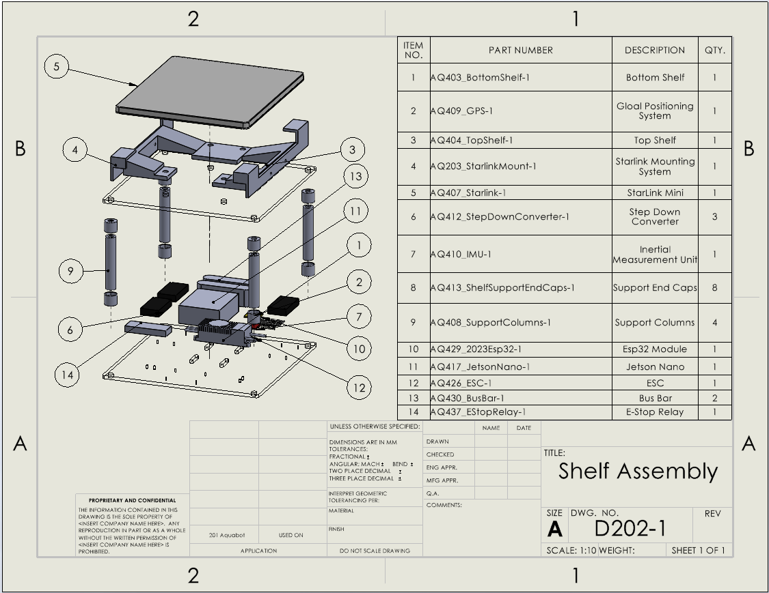
Shelf Subassembly Drawing
Notes:
Kama:
Shelf subassembly hasn’t undergone any changes since CDR

Slide 16

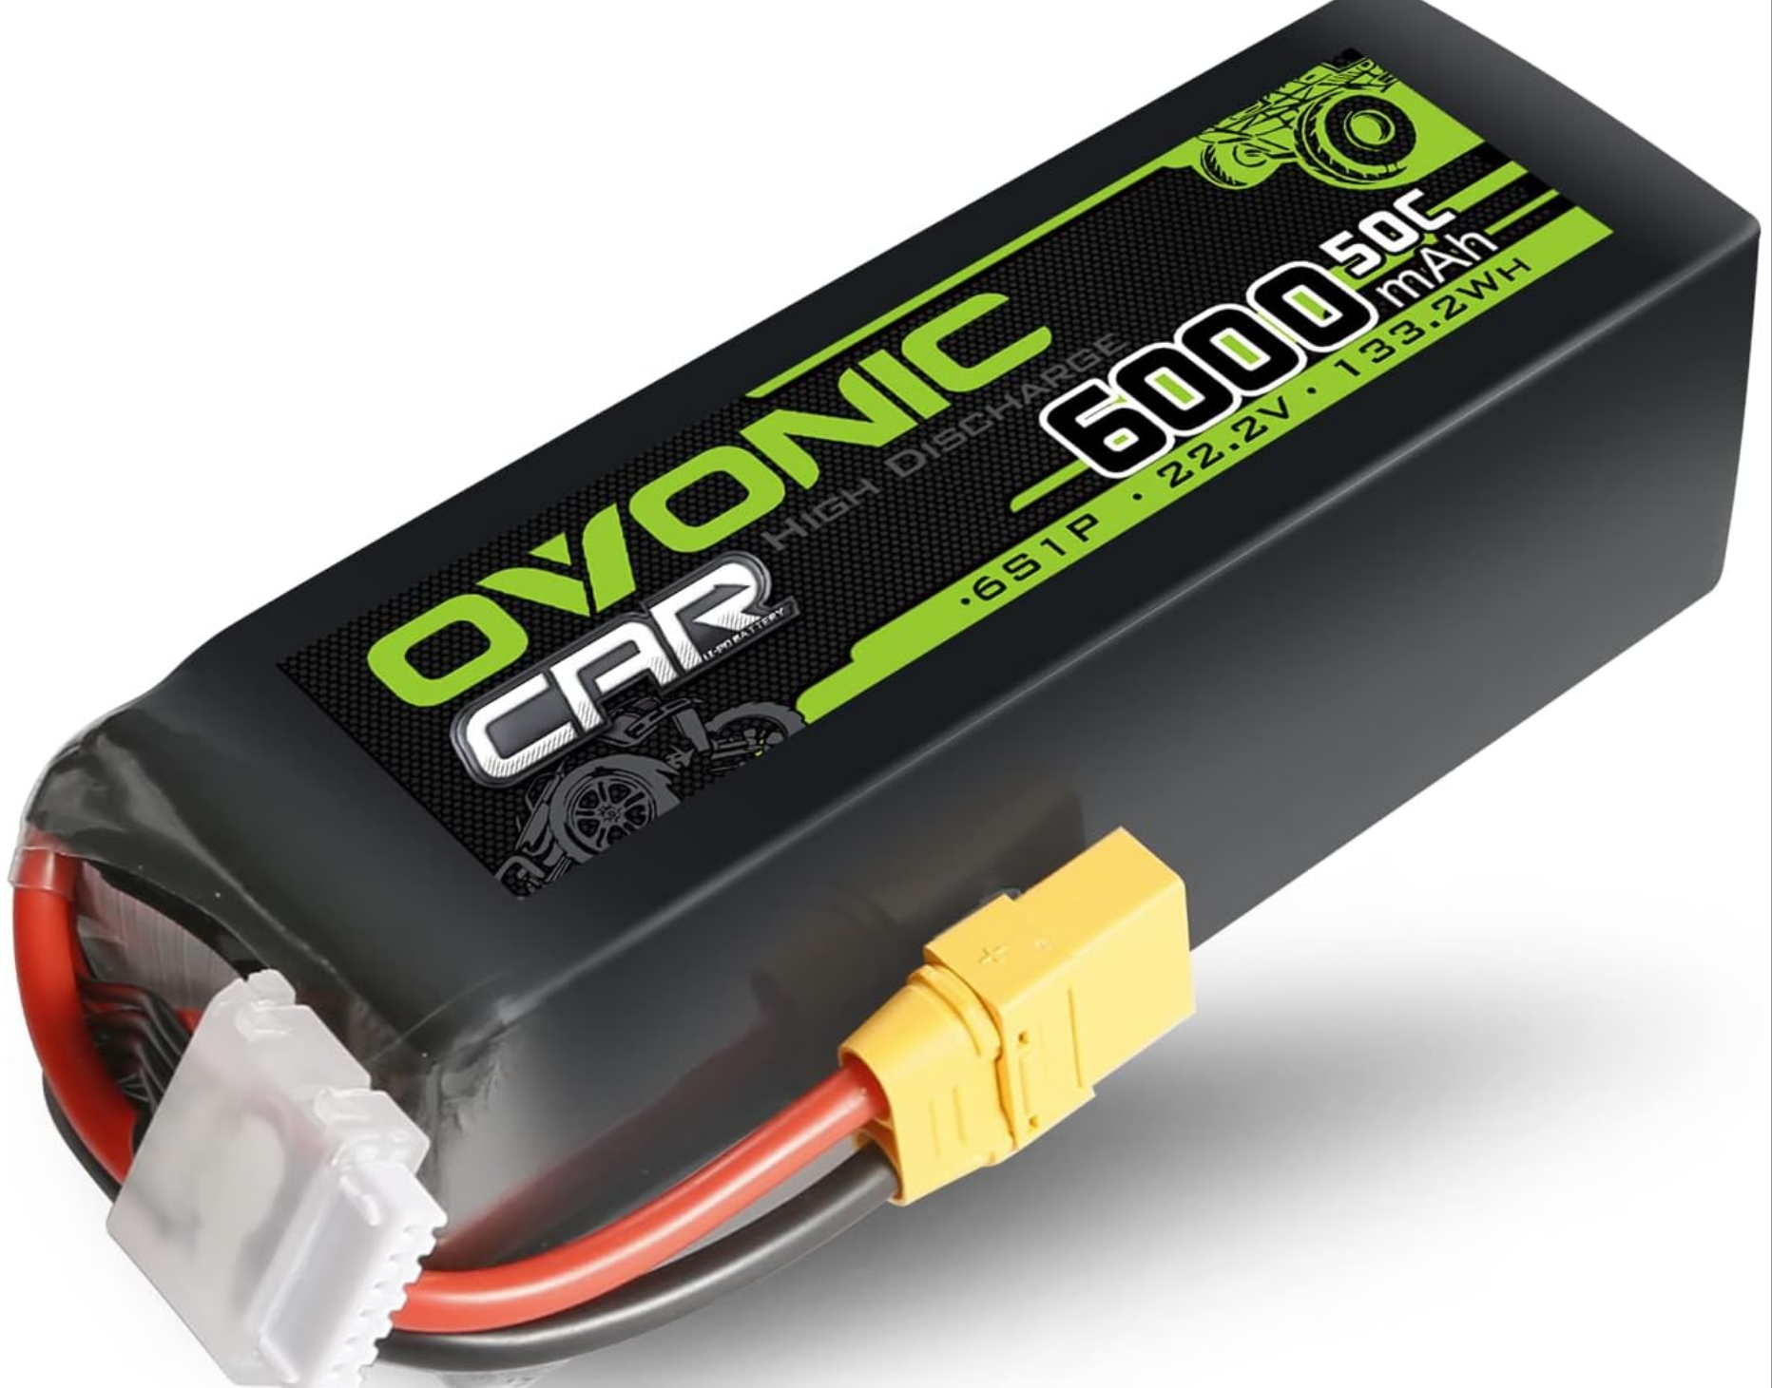
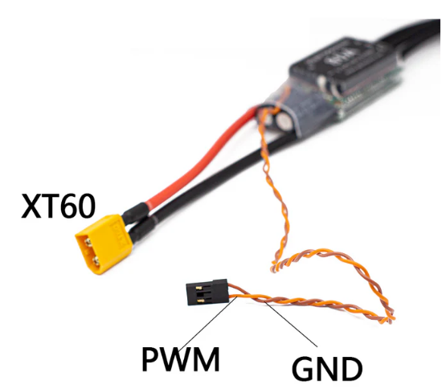
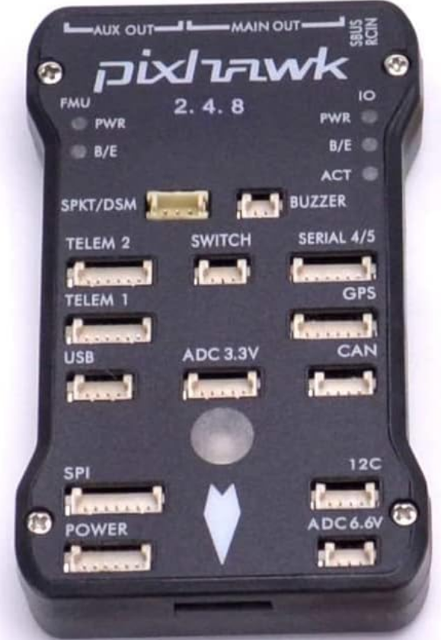
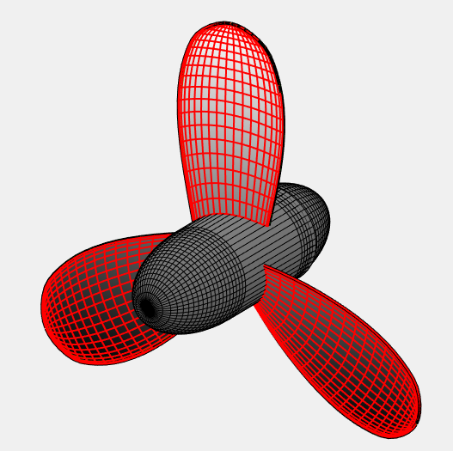
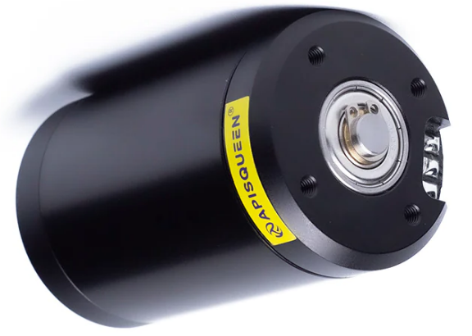
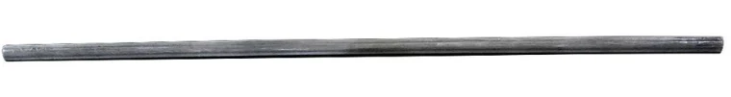
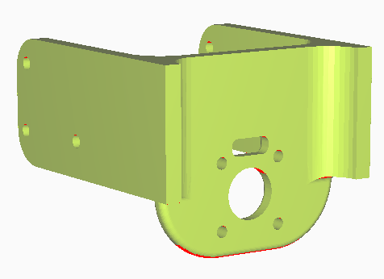
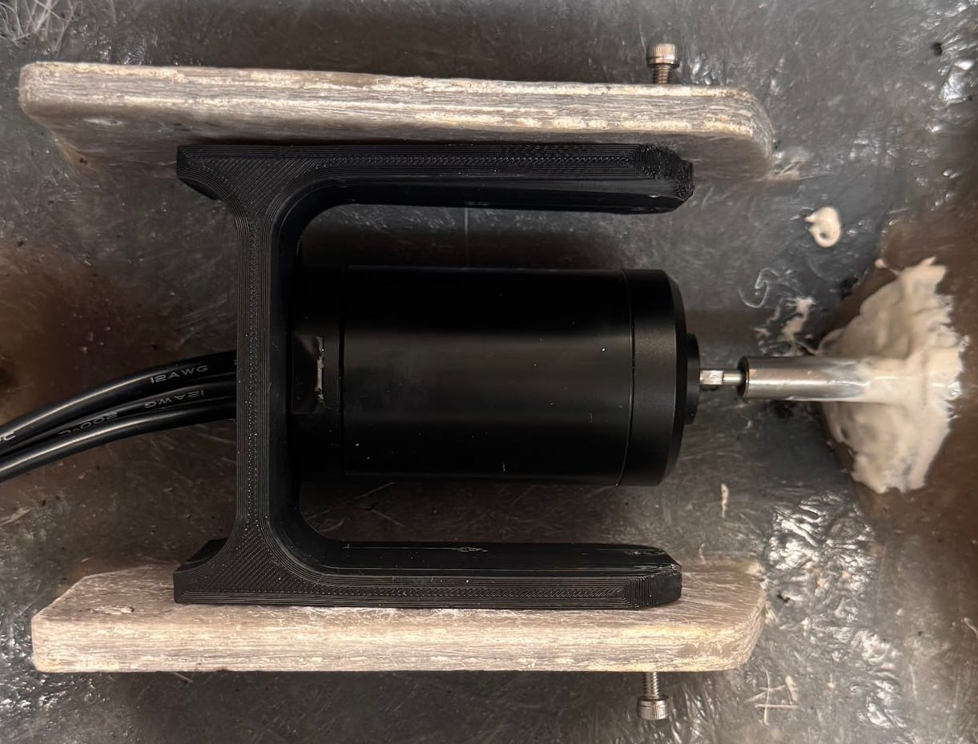
Propulsion Subsystem
Jetson
22.2V
Physical Connection
Flange
Integration Update:
Assembled Motor, mount, shaft, and propeller
Waiting on rudder servo for full assembly
Testing complete: waterproof shaft assy, motor rotation in hull
Notes:
Robert

Slide 17
Propulsion Subsystem Integration Plan
Motor Mounting - Complete by 3/2/2026
  Ensure motor mount holes are aligned with holes on inner-drone mount
  Install and attach 3D Printed Motor Mount Using 4 ¼” bolts and nuts
  Place motor into mount, threading wires toward electronics stack
  Line motor up with propeller shaft (already in place)
  Use joint connection to attach propeller shaft to motor
  Attach motor to power and computer, verify functionality after install
Servo Mounting - Complete by 3/7/2026
  Assess whether servo adhesive is stable enough, otherwise a 3D-printed mount may be needed.
  Adhere servo 1 inch behind rudder shaft
  Use wire and joint connector to connect servo to rudder shaft
  Attach servo to power and computer, verify functionality after install
Electronics Stack - Complete by 3/15/2026
  Reintegrate 1st level of stack into hull, as placed before
  Ensure all connections are properly soldered before installation into stack
  Use velcro to place electronics as outlined by software int. document
  Secure and organize all wires, ensure power supplies supported
  Add 2nd level to stack – with Starlink Antenna Mount

Slide 18
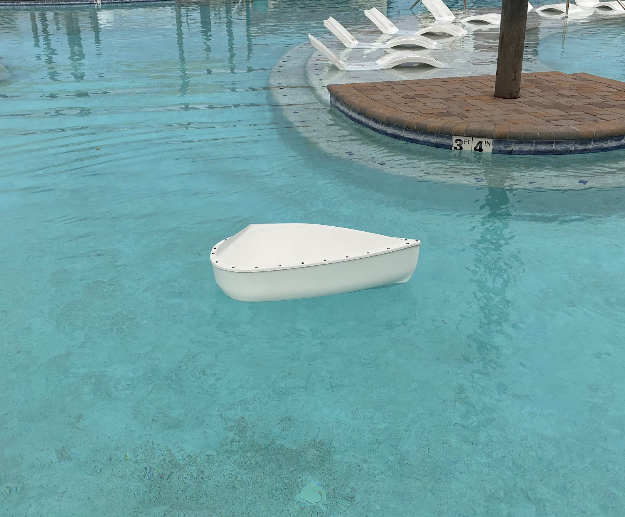

Self-Righting and Waterproofing Subsystem
Testing/Verification (5.1.3, 5.3.2)
Analysis of Torque due to Mass Offset
 | Approximate Center of Buoyancy (mm) | Assembly Center of Mass (mm) | Offset (mm) | Total Mass (kg) | Resulting Torque (N*m)
X (Roll) | 0 | 1.23 | -1.23 | 29.26 | -0.353
Y (Yaw) | -326.54 | -296.47 | -30.07 |  | 0.000
Z (Pitch) | -303.89 | -281.52 | -22.37 |  | -6.421
COM offset only results in a small change in equilibrium pitch
Calculated low COM indicates self-righting capabilities after modifications
Initial self-righting and waterproof testing successful
Extra waterproofing precautions: possible bilge pump implementation, upgraded washers, waterproof sealant
Final testing will be conducted before 3/30/2026
Image showing initial waterproof and self-righting testing
Notes:
Kama:
On left, comparison of COB to COM
It can be seen that COM is below the COM, suggesting self-righting capabilities after modifications
Initial self-righting tests were passed very convincingly
Also, there’s a small offset along the transverse axis which will be reflected by a slight change in pitch when sitting in the water
The offset in the longitudinal direction is negligible, meaning that no roll is expected due to added mass
Initial waterproof testing was also done with kimwipes, which was completely successful when:
Turning propeller shaft
Flipping
Holding underwater at different orientations
For extra waterproofing safety, several precautions have been taken (ordering upgraded washers, waterproof sealant, and a bilge pump)
After all of the components are integrated by March 23, final testing for both waterproofing and self-righting will be conducted soon after

Slide 19
Communications System — Block Diagram
6 integration interfaces across 4 subsystems
Interface Status
DRONE HULL
PIXHAWK
Motor + Servo
(Robert)
IF-1: Swarm↔Pixhawk — Spec Wk 8
IF-2: Sensors→ESP32 — Spec Wk 8
IF-3: ESP32↔Jetson — Spec Wk 8
IF-4: Drone↔Cloud — Spec Wk 8
IF-5: Cloud↔GS — Spec Wk 8
IF-6: Drone↔Drone — ✓ DONE
IF-1
UART/MAVLink
ESP32
Swarm Logic
(John)
SENSORS
pH + Sal + Temp
(Jamie)
IF-2
I2C/ADC
JETSON ORIN
Camera + Starlink
(Jamie/Mayra)
IF-4
Starlink/MQTT
CLOUD
MQTT
IF-3
UART/Serial
IF-6 ESP-NOW
✓ DONE
IF-5
MQTT+WS
OTHER
DRONES
(ESP32)
GROUND
STATION
GUI (Mayra)
Notes:
- Six integration interfaces crossing subsystem boundaries
- IF-6 (drone↔drone ESP-NOW) is the only one fully complete — my primary deliverable
- Remaining five interfaces: specs due this week (Phase 0), paired testing follows
- Critical path: IF-1 (ESP32↔Pixhawk via MAVLink)
- Each interface has paired ownership across team members

Slide 20
9-Step Development Roadmap
Incremental build — each step tested before advancing
1
Scaffolding
2
Identity
3
Discovery
✓ COMPLETE
✓ COMPLETE
✓ COMPLETE
20-file modular arch
ESP-NOW wrapper
NVS provisioning
Persistent node IDs
HELLO/JOIN protocol
50-node capacity
4
Election
5
Commands
6
Formation
✓ COMPLETE
✓ COMPLETE
✓ COMPLETE
Leader + TDMA
50ms slots/beacons
GOTO/HOLD/STOP
Synced execution
4 patterns + move
Leader-distributed
7
Sensor Scaffold
8
Ultrasonic Distance Sensor
9
Avoidance
PLANNED
PLANNED
PLANNED
Sensor abstraction
Mock data API
Real sensor driver
Object detection
Collision avoid
Path planning
Notes:
Here's the full nine-step roadmap. Top row is infrastructure: modular scaffolding, persistent identity, and auto-discovery.
Middle row is coordination: Leader election with TDMA, the command engine, and now formation control.
All six of these are complete and verified on hardware.
Bottom row is planned: sensor scaffolding, mmWave radar integration, and avoidance policy tuning.

Slide 21





Swarm Communications — Status
ESP32-S3 / ESP-NOW • 6 of 9 development steps complete
Development Progress: 6 / 9 Steps
67%
6/9
50
0%
<5ms
<50ms
Steps Complete
Max Swarm Size
Packet Loss
RTT Latency
Command Latency
Completed (Steps 1-6)
Remaining (Steps 7-9)
Step 1: Modular scaffolding + transport
Step 2: NVS persistent node identity
Step 3: HELLO/JOIN auto-discovery (2-4 sec)
Step 4: Leader election + TDMA scheduling
Step 5: Command engine (GOTO/HOLD/STOP/RESUME)
Step 6: Formation control (line/wedge/circle/individual)
Step 7: Obstacle sensor scaffolding
Step 8: mmWave radar integration
Step 9: Avoidance policy tuning
FINAL STEP: Debugging and Stress Testing
Notes:
Six of my nine swarm logic steps are complete. Steps one through five built the core: transport, identity, auto-discovery, leader election, and command distribution.
Step six, which I just finished, adds formation control. The remaining three steps handle obstacle sensing and avoidance
Key numbers: the architecture supports up to 50 nodes, zero percent packet loss, sub-5ms round-trip latency, and under 50 milliseconds end-to-end command latency.
5.1.8 Obstacle Avoidance: Each AQUABOT drone shall detect and avoid obstacles within a 2 meter radius.

Slide 22
Formation Control — Verified
Leader-distributed • Extensible pattern API • Thread-safe
Built-in Formation Patterns
Verified on Hardware — Feb 09, 2026
LINE
CHEVRON
CIRCLE
INDIVIDUAL
Test | Leader (idx 0) | Follower (idx 1) | Result
LINE 2000mm | (0, 0) | (0, -2000) | ✓ PASS
WEDGE 2000mm | (0, 0) | (-1000, -2000) | ✓ PASS
WEDGE 500mm | (0, 0) | (-250, -500) | ✓ PASS
Spacing change | — | Scaled correctly | ✓ PASS
Non-leader | — | Rejected | ✓ PASS
How It Works
Leader sets formation type + spacing
Config broadcast to all nodes via ESP-NOW
Each node calculates its own position from index
Extensible pattern system (function pointers)
Console Commands
formation <type> • spacing <mm> • fmove <x> <y> • fstatus
All Previous Steps Still Working
Discovery ✓
Election ✓
TDMA ✓
GOTO ✓
HOLD ✓
STOP ✓
RESUME ✓
Failover ✓
Thread Safety ✓
Notes:
Step six adds formation control. Four patterns shown here: line, wedge, circle, and individual.
The leader sets the formation type and spacing, broadcasts the config to all nodes, and each node calculates its own position offset based on its index.
Verified on hardware February 09, and the table shows position calculations for line and wedge at different spacings, all correct.
Non-leader restriction is enforced. The followers can't set formation. And every feature from steps one through five still works
5.4.3 Data Relay AQUABOT drones shall transmit collected sensor and positional data to the command unit which shall serve as the primary relay node. - partially verified
5.4.6 4
5.4.6 Swarm Control: The AQUABOT swarm shall maintain coordinated network behavior through a leader-follower model executed via Jetson Mission Computer and MQTT topics. Each drone shall publish and subscribe to swarm state messages at ≥ 1 Hz with < 1 s latency.

Slide 23

Hardware & Verified Metrics
ESP32-S3 • All performance metrics exceed requirements
ESP32-S3 Platform
Resource Usage (per node)
MCU: Xtensa Dual-Core @ 240 MHz
Radio: 2.4 GHz WiFi (ESP-NOW protocol)
Range: 30m+ indoor, 100m+ outdoor (line of sight)
UART0=Console, UART1=Pixhawk, UART2=Jetson
RTOS: FreeRTOS • Storage: NVS Flash
Currently verified on 2 dev boards
Resource | Usage
Flash | ~800 KB
RAM | ~10 KB
CPU Load | <5%
Network Traffic | ~50-100 B/sec
Modules | 9 (6 active, 3 stub)
4-5 ms
0%
-16 to -24 dBm
2-4 sec
RTT Latency
Packet Loss
Signal (RSSI)
Discovery Time
Req: <10 ms
Req: <5%
Req: >-70 dBm
Req: <5 sec
PASS
PASS
PASS
PASS
Notes:
Running on ESP32 with ESP-NOW, that's direct peer-to-peer, so no WiFi access point needed.
Very lightweight: under five percent CPU, about 10 kilobytes of RAM.
Four key performance metrics, all exceeding requirements. Four to five millisecond round-trip, zero percent packet loss, excellent signal strength, and two to four second discovery time.

Slide 24
SRVM Verification – Requirement 5.4.2
Inter-Drone Communication: PARTIAL PASS → Advancing to FULL PASS
Verification Method | Status | Evidence / Detail | Date
TEST | ✓ PASS | RTT <5ms | 0% loss | RSSI -16 to -24 dBm | Discovery <5s | Wk 6
DEMONSTRATION | ✓ PASS | 2-node swarm: auto-discovery, leader election, TDMA, cmd sync | Wk 6
ANALYSIS | ◐ In Progress | Scalability 2→50 nodes, traffic modeling, performance projections | Wk 9
INSPECTION | ○ Planned | Hardware inspection, antenna placement, enclosure RF check | Wk 12
Other Requirements
5.3.1 Survivability – ◐ Test: ✓ COMMS PASS (0% packet loss w/ calm conditions) | Analysis: Scheduled Wk 9
5.4.3 Data Relay – Demonstration: ◐ PARTIAL (positional data sent, sensor data pending)
5.4.1 Autonomy & Control – Demonstration: ◐ PARTIAL (command execution OK, formation pending) - NO CHANGE
Notes:
- Requirement 4.4.2 currently at PARTIAL PASS, advancing to FULL PASS
This is the SRVM update two interface requirements.
For 4.4.1 Autonomy and Control, no change. Still partial pass for demonstration, which depends on propulsion integration.
For 4.4.2 Inter-Drone Communication, we've made progress on two fronts. Test has been upgraded from partial pass to full pass — steps one through six are all verified on hardware with zero packet loss and sub-five-millisecond latency.
Demonstration has been upgraded from X to partial pass — we've shown end-to-end swarm communication on two nodes. Path to full pass is completing steps seven through nine and running a multi-node testing and demonstration
5.4.3 Data Relay AQUABOT drones shall transmit collected sensor and positional data to the command unit which shall serve as the primary relay node.

Slide 25

Power Subsystem/Electrical
Design unchanged from CDR • Fuse protection upgraded • All parts ordered
Changes Since CDR
Unchanged from CDR
Main fuse upgraded: 80A → 150A (MRBF holder)
Added dedicated 125A motor fuse (MIDI block)
Proper fuse blocks: MRBF + MIDI + ST Blade ATO
Added thermal pads for heat management
6S LiPo battery architecture (22.2V)
Busbar distribution (+/- rails)
Voltage converters: 5V, 12V buck
Castle BEC for rudder servo (7.4V)
Manual kill switch + master safety
22.2V
150A
125A
~155W
~51 min
Battery Voltage
Main Fuse
Motor Fuse
Cruise Draw
Cruise Endurance
6S LiPo
MRBF Block
MIDI Block
All Systems
133.2 Wh
Notes:
- Power architecture unchanged from CDR — same battery, same voltage rails, same converters
- What DID change: upgraded fuse protection — 80A to 150A main, added dedicated 125A motor fuse, proper marine-grade fuse blocks
- Added thermal management and cleaner DC connections
- Key numbers: 22.2V battery, ~155W cruise, ~51 minutes endurance

Slide 26
Power System — Block Diagram
6S LiPo Battery
22.2V / 6Ah / 133 Wh
MRBF — 150A
Kill Switch
(+) Busbar 22.2V Rail (–) Busbar
MIDI — 125A
ST Blade ATO
ST Blade ATO
ST Blade ATO
ST Blade ATO
ST Blade ATO
ESC → Motor
22.2V / 54A max
Starlink
22V / 2.7A
5V Power Module
12V Buck
5V Buck
BEC
Pixhawk 4X FC
5V
Cooling Fan +
Jetson Orin Nano
12V
ESP32
5V
Rudder
Servo
7.4V
3.3V reg
3.3V reg
Power Source
Fuse / Safety
Converter
Load
Bus / GND
Camera
3.3V
Sensors
3.3V
Notes:
- Battery feeds through 150A MRBF fuse and kill switch to bus bars
- Bus bars distribute 22.2V to fused branches
- MIDI 125A fuse protects the motor/ESC branch
- ST Blade ATO fuses protect aux circuits
- Converters step down to 12V (Jetson), 5V (ESP32), and 12V for Starlink
- BEC provides 7.4V for rudder servo

Slide 27
Wiring Diagram — Interconnects & Cable Sizing
+
MIDI 125A
–
to ESC (Motor)
Red 8 AWG / Blk 10 AWG
ATO 7.5A
(Slow-Blow)
to Starlink
Red 16 AWG / Blk 16 AWG
ATO 7.5A
(Slow-Blow)
to 12V Buck (Jetson + Fan)
BATTERY
6S LiPo 22.2V
XT-60
Red 4 AWG
MRBF
150A
KILL
SWITCH
Red 18 AWG / Blk 18 AWG
ATO 1A
to 5V Buck (ESP32)
Red 18 AWG / Blk 18 AWG
ATO 1A
(Slow-Blow)
to 5V Power Mod (Pixhawk)
Red 18 AWG / Blk 18 AWG
ATO 2A
(Slow-Blow)
to BEC (Servo)
Red 18 AWG / Blk 18 AWG
Blk 4 AWG
Signal & Data Interconnects
Connection | Protocol | Signal | Cable | Connector
ESP32 → Pixhawk (IF-1) | MAVLink / UART1 | TX/RX 3.3V | 22 AWG | JST-SH 4-pin
ESP32 → Jetson (IF-3) | UART2 115200 | TX/RX 3.3V | 22 AWG | JST-SH 4-pin
ESP32 → ESC (PWM) | PWM 50Hz | 3.3V logic | 22 AWG | Servo 3-pin
Jetson → Camera (CSI) | MIPI CSI-2 | LVDS diff | Ribbon | 15-pin FPC
Jetson → Starlink | Ethernet | 100BASE-T | Cat5e | RJ-45
Notes:
- Battery connects through 8 AWG wire to MRBF 150A main fuse, then kill switch, then + bus bar
- Each branch is individually fused: MIDI 125A for motor, ATO fuses for aux circuits
- Wire gauges sized to current: 10 AWG for motor (54A max), 16 AWG for PoE/boost, 18-20 AWG for logic converters
- Signal interconnects: UART for Pixhawk and Jetson, PWM for ESC, CSI for camera, Ethernet for Starlink

Slide 28
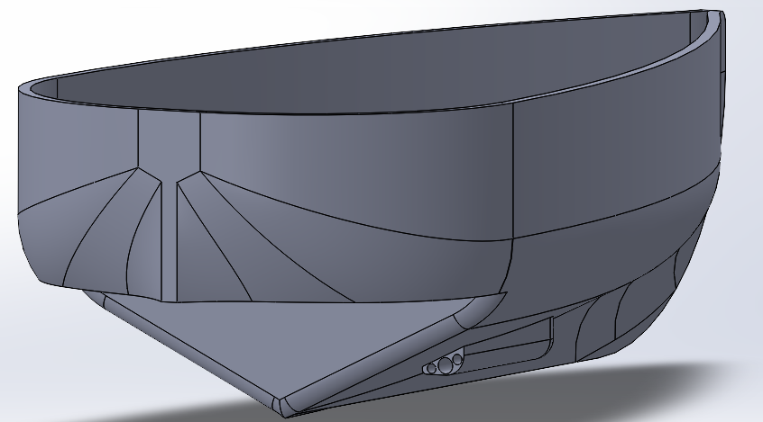
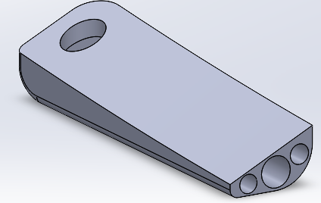
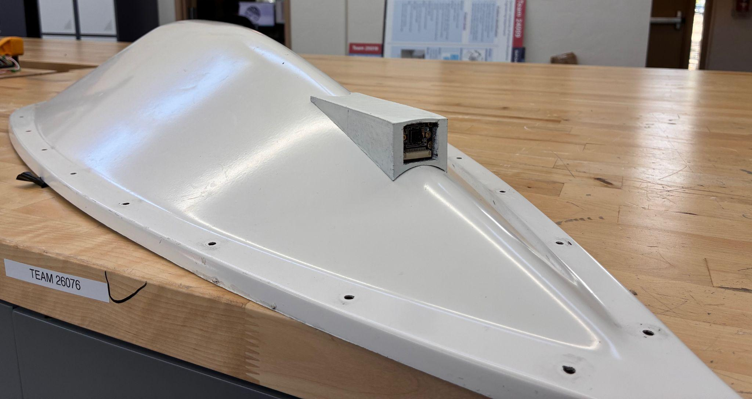
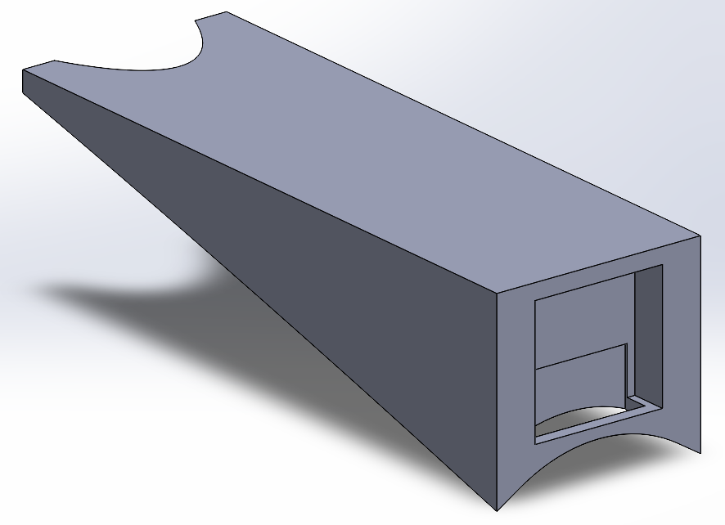
Sensors and Camera Integration
Progress Since CDR:
Mounts optimized
Drag reduced for sensor mount
Stability improved on camera mount
Camera successfully mounted
New pH sensor selected – prior choice faulty CDE2 Delay
Next Steps:
Waiting on pH sensor arrival
Program pH sensor inline with temp. and conductivity sensor
Integrate into hull
Notes:
Jamie

Slide 29
Critical Design Element (CDE-2) Progress
CDE-2 Goal:
Demonstrate sensor and camera connectivity to the ground station GUI, while being integrated into the drone hull itself.
Current Status:
Camera is integrated with partial verification of functionality. Sensor suite still awaiting integration due to pH sensor replacement– functionality of temperature and conductivity sensor is partially verified.
Next Steps:
After pH sensor arrives, sensor suite programming will be finalized (1-2 days), and then mounted (1 day).
Verification of function within hull & waterproofing will be done at pool by 3/3/26.
Notes:
Jamie

Slide 30
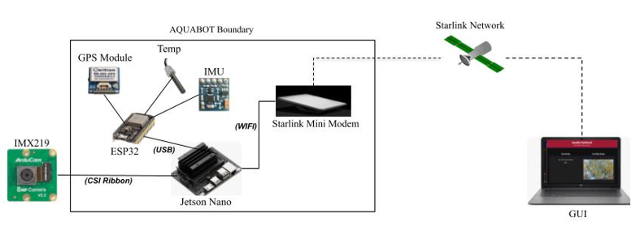
Geo-Overlay and Telemetry Integration
IMX219 camera sends 1080p video to the Jetson via CSI ribbon
ESP32 collects GPS, IMU, and temperature data and sends telemetry to Jetson over USB
Jetson synchronizes video + telemetry and prepares outgoing data stream
Jetson connects to Starlink Mini via Wifi for remote communication
Starlink network relays live video + telemetry to the GUI
GUI displays real‑time video, GPS position, heading, and temperature and supports two‑way commands
Notes:
Mayra

Slide 31
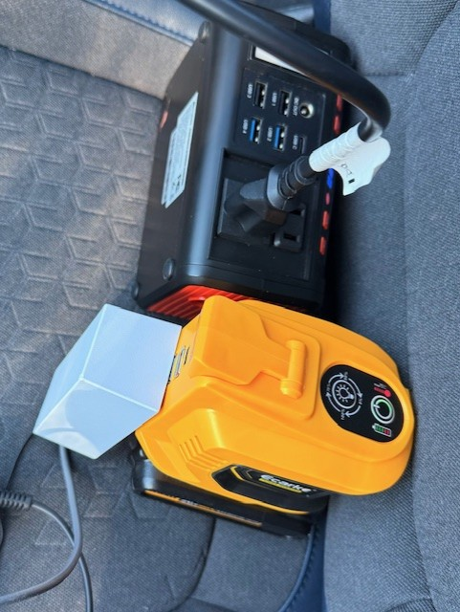
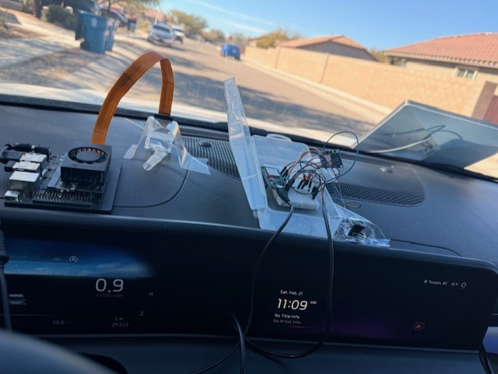
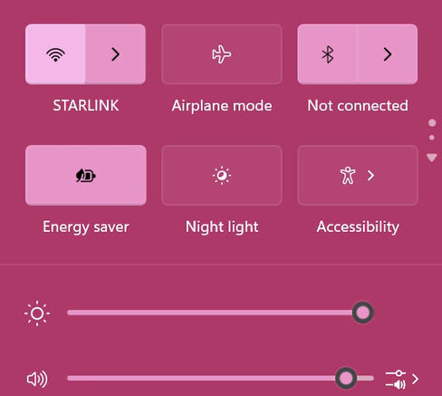
Demo Setup
Starlink Mini
IMX219
Power for Jetson & Starlink
Starlink Network
Connection
Jetson Nano
ESP32: GPS, IMU & Temp

Slide 32
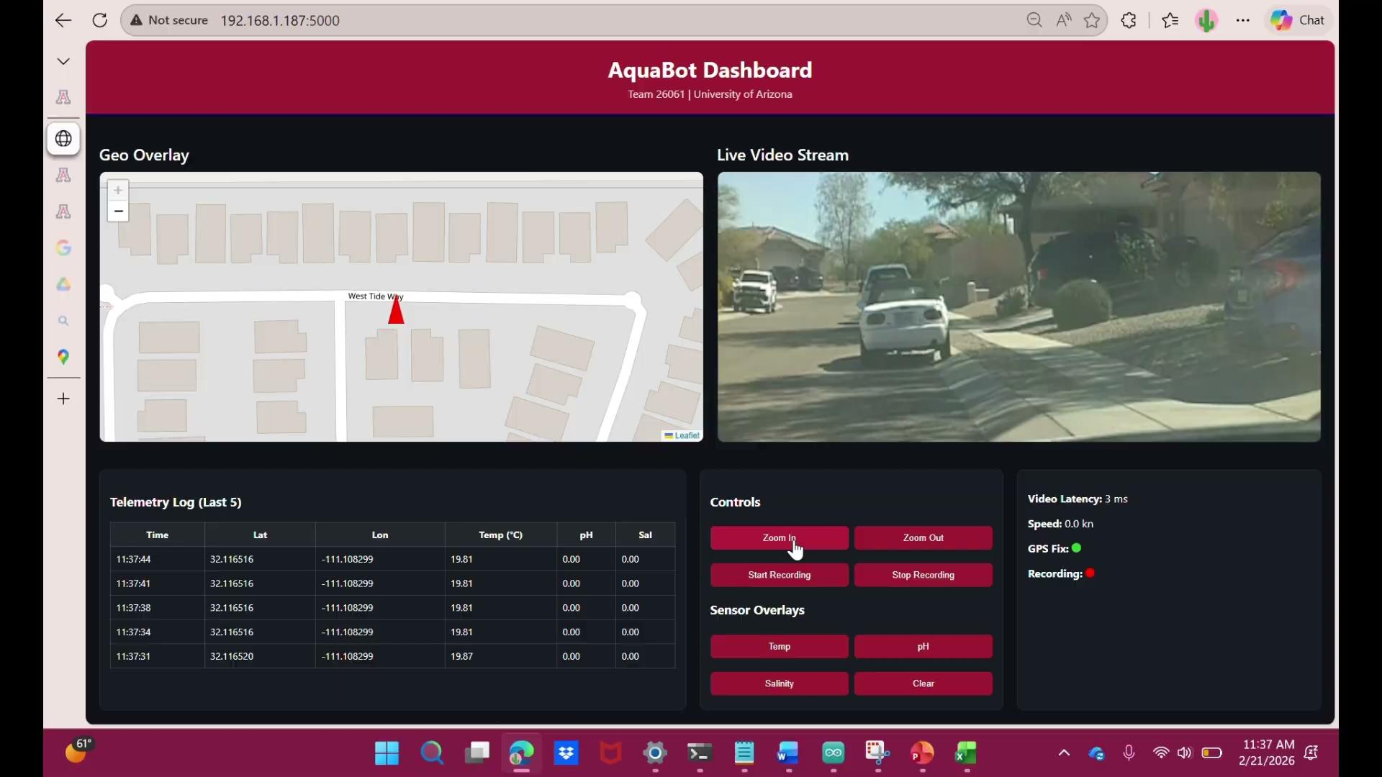

Geo-Overlay Demo
Results:
Live 1080p video successfully streamed over Starlink
Geo‑overlay displayed correctly with real‑time GPS updates
Telemetry (GPS, IMU, Temp) received at expected 3‑second interval
GUI controls functional (zoom, record, overlays)
Recording triggered from GUI and saved on Jetson with matching timestamps
End‑to‑end Jetson ↔ GUI communication confirmed
For Reference:
Notes:
Mayra

Slide 33
Testing and Verification

Slide 34

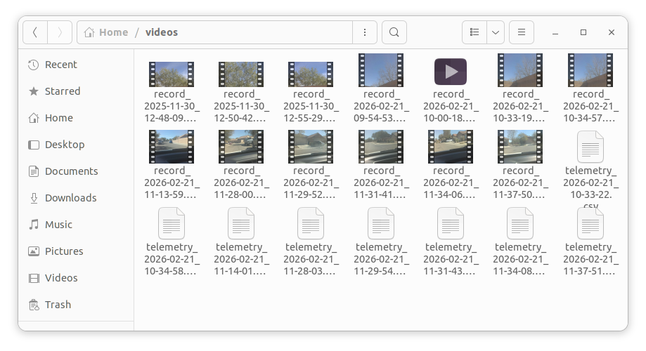
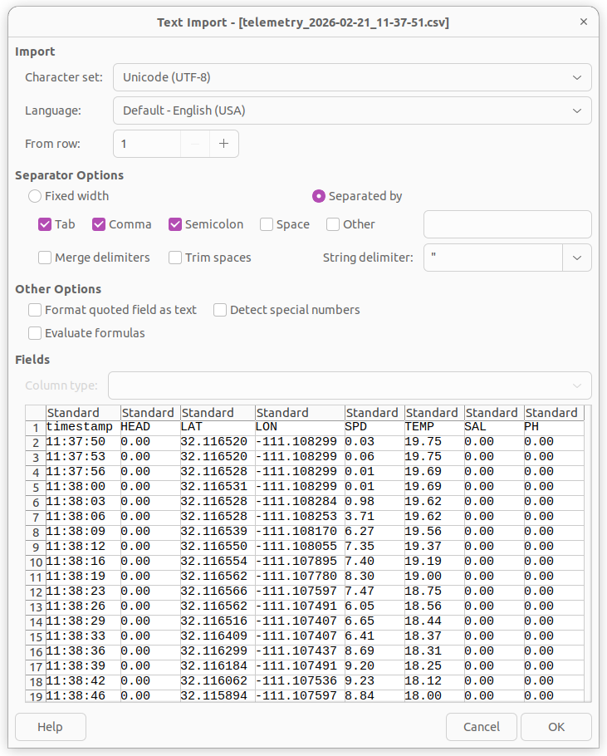

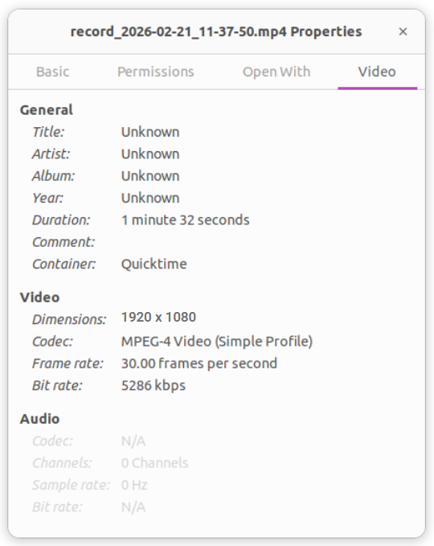
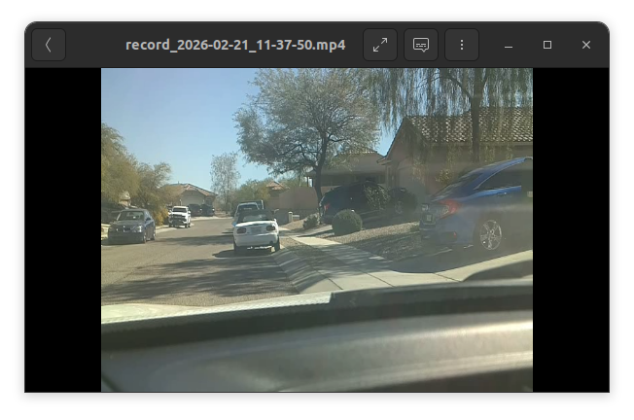
Data Transmission Verification
4.1.6 Data Collection
GUI triggers recording on Jetson
1080p/30fps video verified
Telemetry logged every 3 seconds
Video + CSV stored with matching timestamps
Jetson ↔ GUI communication confirmed
4.1.7 Data Mapping
GPS + Temp exported as GIS‑compatible CSV
Synchronized video + telemetry
Real‑world mapping validated
Notes:
Mayra

Slide 35
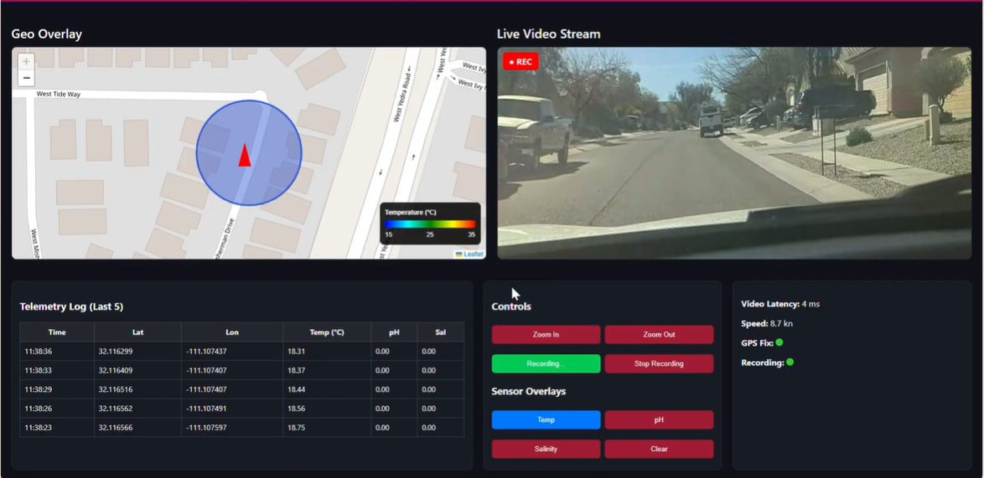
Geo-Overlay Verification
Map updates with GPS
Temperature overlay toggles correctly
Real‑time position and heading displayed
Live-Video Streaming
4.4.5 Display

Slide 36
Communication Subsystem Verification Plan
Requirement | Status | Remaining Action | Target
5.3.1 Survivability | ◐ Comms Pass (0% loss calm) | Test with wave / stormy conditions on lake | Wk 9
5.4.3 Data Relay | ◐ Partial (Position✓) | Integrate Jamie's sensor pipeline; demo full telemetry stream | Wk 11
4.4.1 Autonomy & Control | ◐ Partial (commands ✓) | Implement formation control (Step 6); pool demo all 4 formation types | Wk 13-14
5.4.2 Inter-Drone Comms | ✓ ESP-NOW verified | Validate 100m range in pool environment | Pool Test
5.4.6 Swarm Control | ◐ ESP-NOW layer done | Bridge ESP32→ Jetson via MAVLink/serial; implement MQTT pub/sub ≥1 Hz, verify <1s latency | Wk 12
Notes:
Comms requirements are partially verified: survivability and inter-drone comms are in good shape, just need real-environment validation. Data relay and formation control are pending subsystem integration with Jamie and the propulsion team. Swarm control needs the ESP32-to-Jetson bridge — that's our Week 12 target. Every requirement has a clear close-out path.

Slide 37
Propulsion Subsystem Verification Plan
4.1.3 - Stability
  Drone will be placed in the water in different positions and shown to return to its running orientation
4.1.4 - Speed
  Drone will be run at speed at constant power over a measured distance in calm water, and timed.
  This test will be conducted 3 times to determine speed
4.3.3 - Operating Temperature
  Drone will be run at determined cruise power for 30 minutes and the internal temperature will be measured
Notes:
Alex

Slide 38
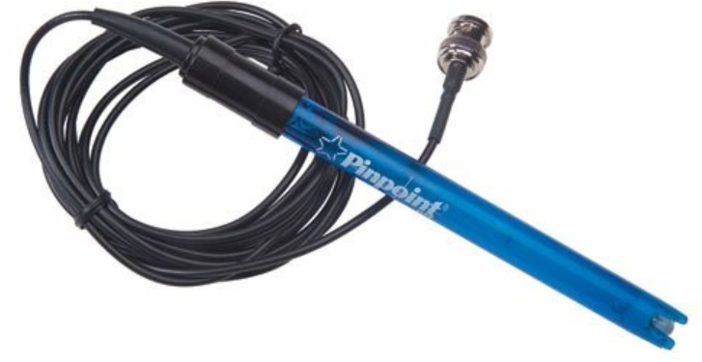
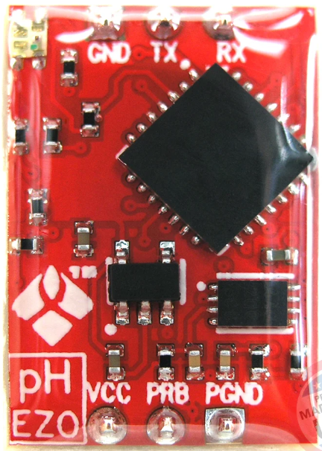
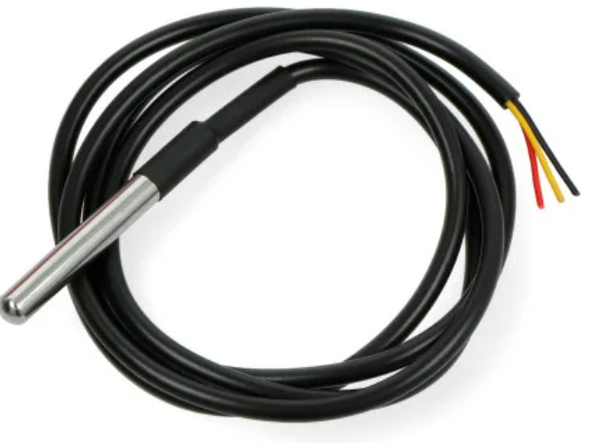
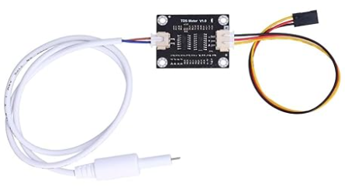
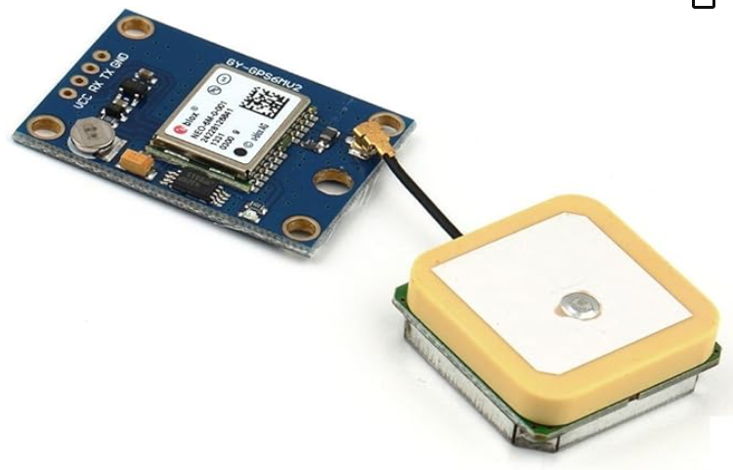
Sensors Verification Plan
pH Probe
CSV File in Format:
Date,Time, Lat., Long., Speed, GPS Fix, Temp., Cond., pH.
Temperature Probe
In order to verify full functionality of sensor suite, sensors will be tested using known, calibrated substances of varying temperature, salinity, and pH. These values will be confirmed at the ground station GUI, and necessary calibration curves will be constructed and applied.
Conductivity Probe
GPS Module
Notes:
Jamie

Slide 39
Sensor Requirements Verification
5.1.6 Data Collection: Each AQUABOT drone shall measure temperature, salinity, pH, and capture visual imagery at a minimum of 1080p resolution, 30 fps.
5.4.5 Display: The display shall show half the display with Geo-overlay and the other half will display live-streaming.
5.2.4 Payload Mounts: The hull shall provide standardized, sealed mounts for Starlink terminal, battery, and sensor payload.
5.3.2 Waterproofing: Each aquatic AQUABOT drone shall meet IP68 ingress protection standards IAW IEC 60529:1989 + AMD1:1999 CSV. Waterproof components shall be tested in 1.5 m depths to ensure compliance.
Notes:
Jamie

Slide 40
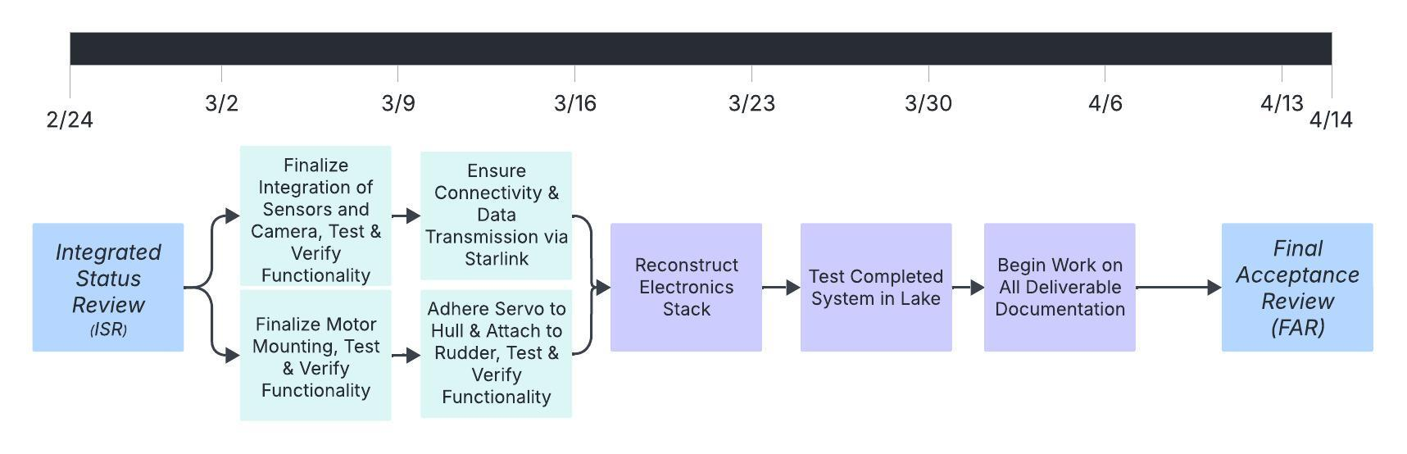
Final Acceptance Test Plan
Notes:
Jamie

Slide 41
Risk Analysis

Slide 42
Risk Analysis: Integration
Impact | 5 | R003/4 |  | R001
 | 4 |  | R002
 | 3 | R005
 | 2
 | 1
 |  | 1 | 2 | 3 | 4 | 5
 |  | Likelihood
ID | Risk Description | Severity (L x I)
R001 | GPS accuracy leads to swarm control problems | 15
R002 | Structural motor mount failure | 8
R003 | Battery failure via thermal runaway | 5
R004 | Bus bars unable to mitigate voltage drop across components | 5
R005 | Jetson unable to establish connection to Cloud | 3
Impact | Likelihood
5 - Catastrophic | 5 - Near Certainty
4 - Major | 4 - Highly Likely
3 - Moderate | 3 - Likely
2 - Minor | 2 - Somewhat Likely
1 - Insignificant | 1 - Not Likely
 | High Risk
 | Moderate Risk
 | Low Risk
Notes:
Robert

Slide 43
Risk Analysis: Mitigation Plan
R001 (High): Swarm Control (ESP32) to Flight Controller (PIXHAWK) connection
Test control code through simulated environment (ideal conditions)
Initial/ final environment → low res GPS data (5m accuracy)
  Determine if a secondary system is needed for maneuvers before separation
Separation distance set to 50% of max range
R002 (Moderate): Structural failure of motor mount/ flange
Conduct structural tests on ABS-CF motor mount and flange at max RPM for 1 hour
  Determine if ABS-CF is enough in real environment → if not: use machine shop SS
  Determine if shaft is thick enough
Notes:
Robert

Slide 44
Risk Analysis: Mitigation Plan
R003 (Moderate): Battery failure
Safely charge battery when in use
Safely discharge batteries when not in use
Use BMS and kill switch to shut off battery if failure does happen
R004 (Moderate): Voltage drop across bus bars
‘Physical’ Mitigations:
  Use overrated bus bars at 250A, when ~25A is needed
  Use separate battery for motor (largest instant voltage drop)
  Minimize wire distance for high current components
Conduct testing at max electrical load to ensure no severe voltage drops
Notes:
Robert

Slide 45
Cost Analysis and Deliverables
Notes:
Jamie

Slide 46
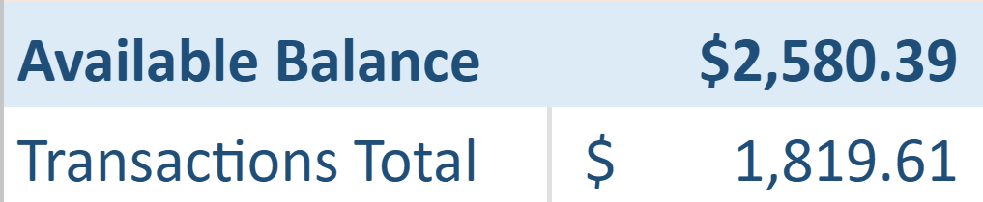
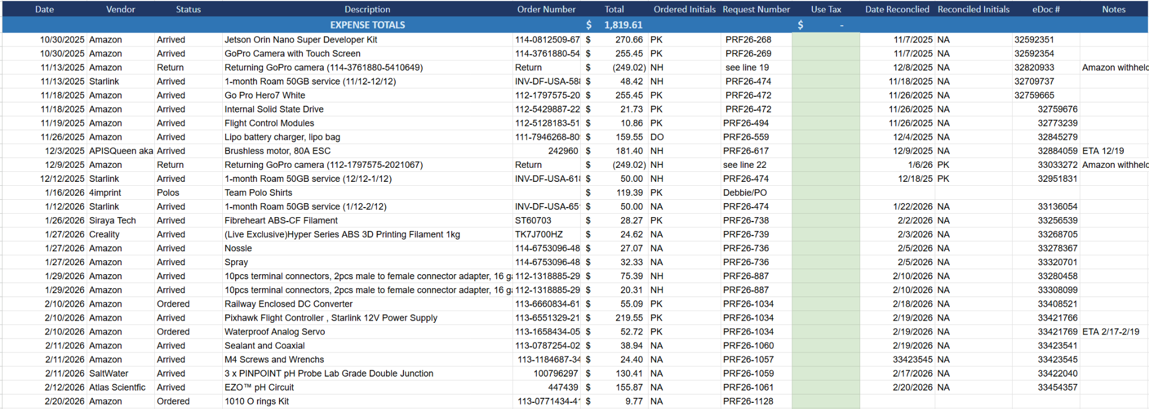
Cost Analysis
Within Budget
Notes:
Robert

Slide 47
Deliverables
Deliverable | Date | Description
Programmed Cameras and GUI | 12/9/2025 | Camera connected and linked to GUI
Programmed Sensor Suite | 12/9/2025 | Sensors and GPS integrated
Materials CAD | 12/9/2025 | CAD for all major systems complete
Communication Module | 2/26/2026 | Starlink integrated with all components & GS.
Propulsion System | 3/5/2026 | Functional propulsion system w/ motor control
Operational Ground Station | 2/28/2026 | GUI and backend for live data transmission
Functional Hull Prototype | 3/5/2026 | Hull integrated with all components
Manual | 4/14/2026 | Includes documentation and user guides
Project Final Report | 5/5/2026 | Includes summary, system specs, and results
Notes:
Jamie

Slide 48
Summary
Notes:
Jamie

Slide 49
Summary
Major Accomplishments:
Via thorough testing, several requirements have already been fully passed (inter-drone communication, ground station communication, etc.)
Communication between two drones with preparations for communication between several drones has been completed
Significant progress towards physical integration of motors and sensors has been made using redesigned mounting systems
Significant progress has been made towards finalizing the GUI and transmitting data to the ground station
Moving towards FAR:
Most concerned about inconsistencies in the environment affecting the system
  Waves
  Weather
  Network/radio traffic
Notes:
Kama:
Accomplishments we’re most proud of:
First, we’ve been productive since CDR, being able to fully pass several major requirements
Next, we’ve put in a lot of work totwards inter-drone communication
Established a strong connection between 2 drones
Preparations made toward inter-drone comms within a swarm
Progress towards physical integration
We’ve also successfully integrated the motor into the aquabot, with adaptations made to the previous teams’ work
Mounts printed and partially integrated to allow for sensing in the future
We’ve also been able to make significant progress towards completing the GUI and transmitting data from our sensors to the ground station
As FAR approaches, we’re most concerned with environmental factors:
Things such as waves, weather, or interference between drones and outside equipment could affect the system
We may see results deviating from those found during testing, so we plan to introduce factors like this as we continue verification
Thank you for attending our ISR presentation

Slide 50
Questions & Discussion
Notes:
17

